Slide 1

GNIKOOB EUNEV
VENUE BOOKING
JAVA PROGRAMMING

Slide 2


INTRODUCTION :
Venue booking system is a System application in which a customer or a venue owner can register their venues and customers can book venues for events as per their location, availability and interests.

Slide 3

Common Travel Seasons
PROBLEM STATEMENT
The Following Modules are present in the project: Dealer and Customer
Dealer: The dealer needs to register in the application before getting logged in. After getting logged in, The application welcomes Dealer with Dealer home screen, showing the functionalities of Dealer. He can add venues and view the Customer requests and accept them as well.
Customer: Customer needs to be registered into the application before getting logged in, after getting the login access Customer will search for the venues based on the location. Then Customer will see the list of venues available in that location and book any one of them and the request will be forwarded to the Dealer.
VENUE

Slide 4



SCOPE AND IMPORTANCE
Venue Booking system is the best way to keep clients engaged with the service as they are on the move.
1
The main aim of this proposal is to develop an online venue booking system which can reduce the manual work
2
Editing, adding and updating of Records is improved which results in proper resource management of Payment data.
3

Slide 5

DEVICE REQUIREMENTS:
⚙️ Hardware Requirements: Computer with either Intel processor or AMD processor. 2GB+ DDR RAM. 2GB hard disk drive.
💻 Software Requirements:
Windows/ MacOS/ Linux operating system. JRE and JDK. MYSQL server (WAMP). MYSQL JDBC driver - mysql-connector-java-8.0.18.jar

Slide 6
USER INTERFACE AND WHAT IT’S GONNA BE LIKE

Slide 7
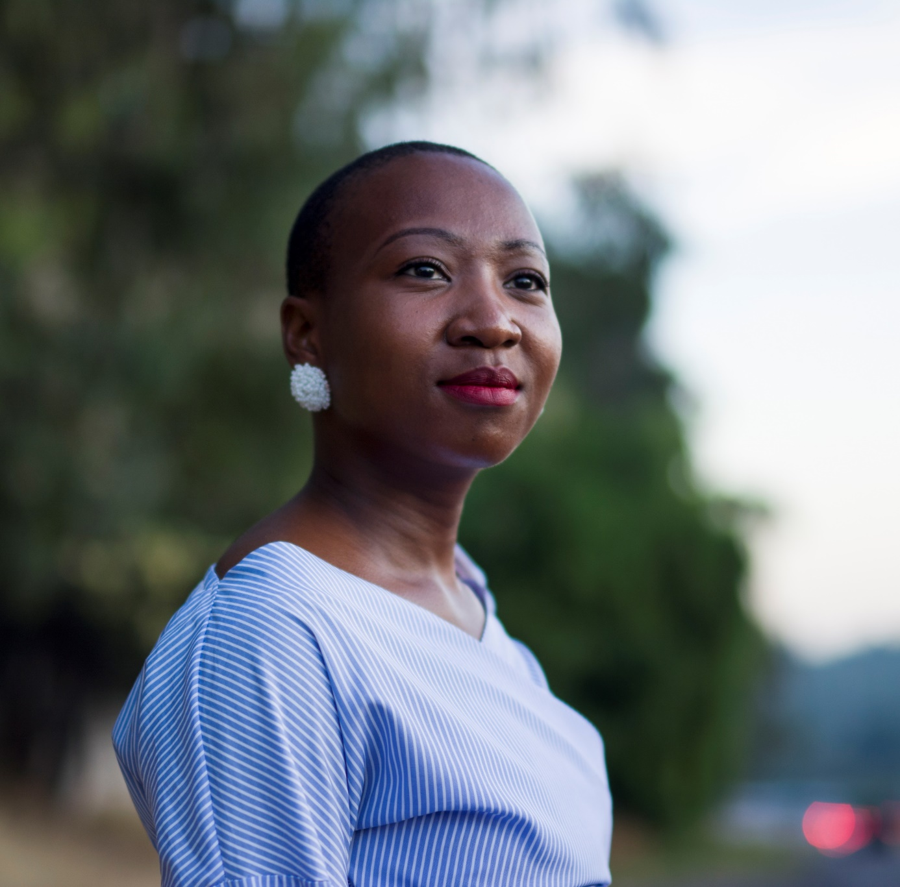
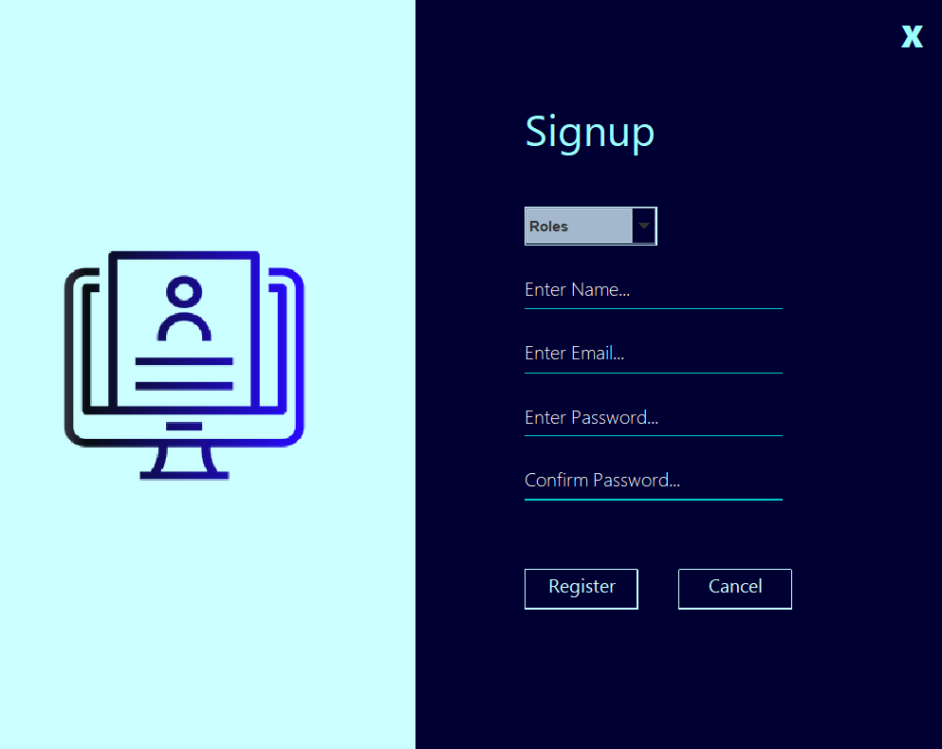
Signing up with us
What it’s gonna be like!

Slide 8
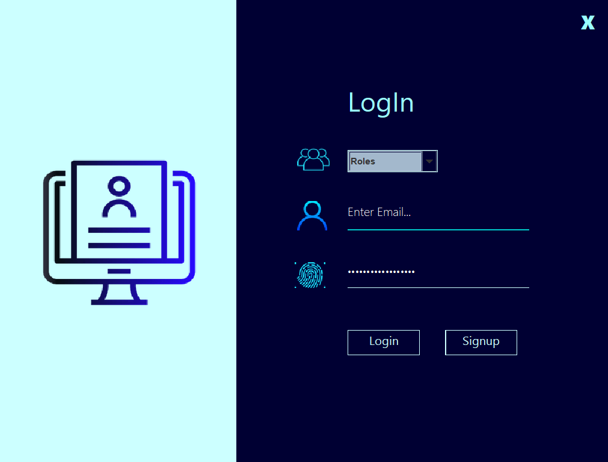

Logging IN !
What it’s gonna be like!

Slide 9
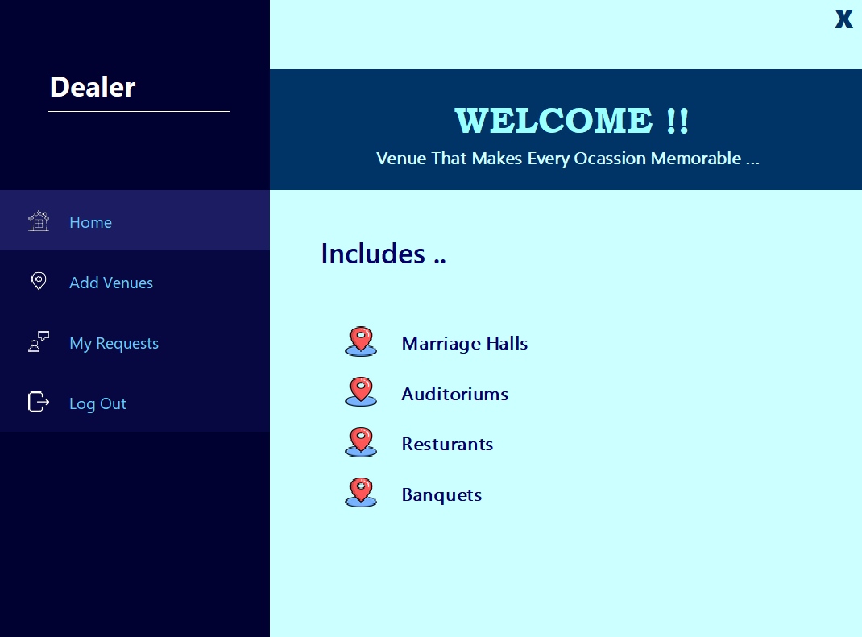
On Customer’s home screen
What it’s gonna be like!

Slide 10
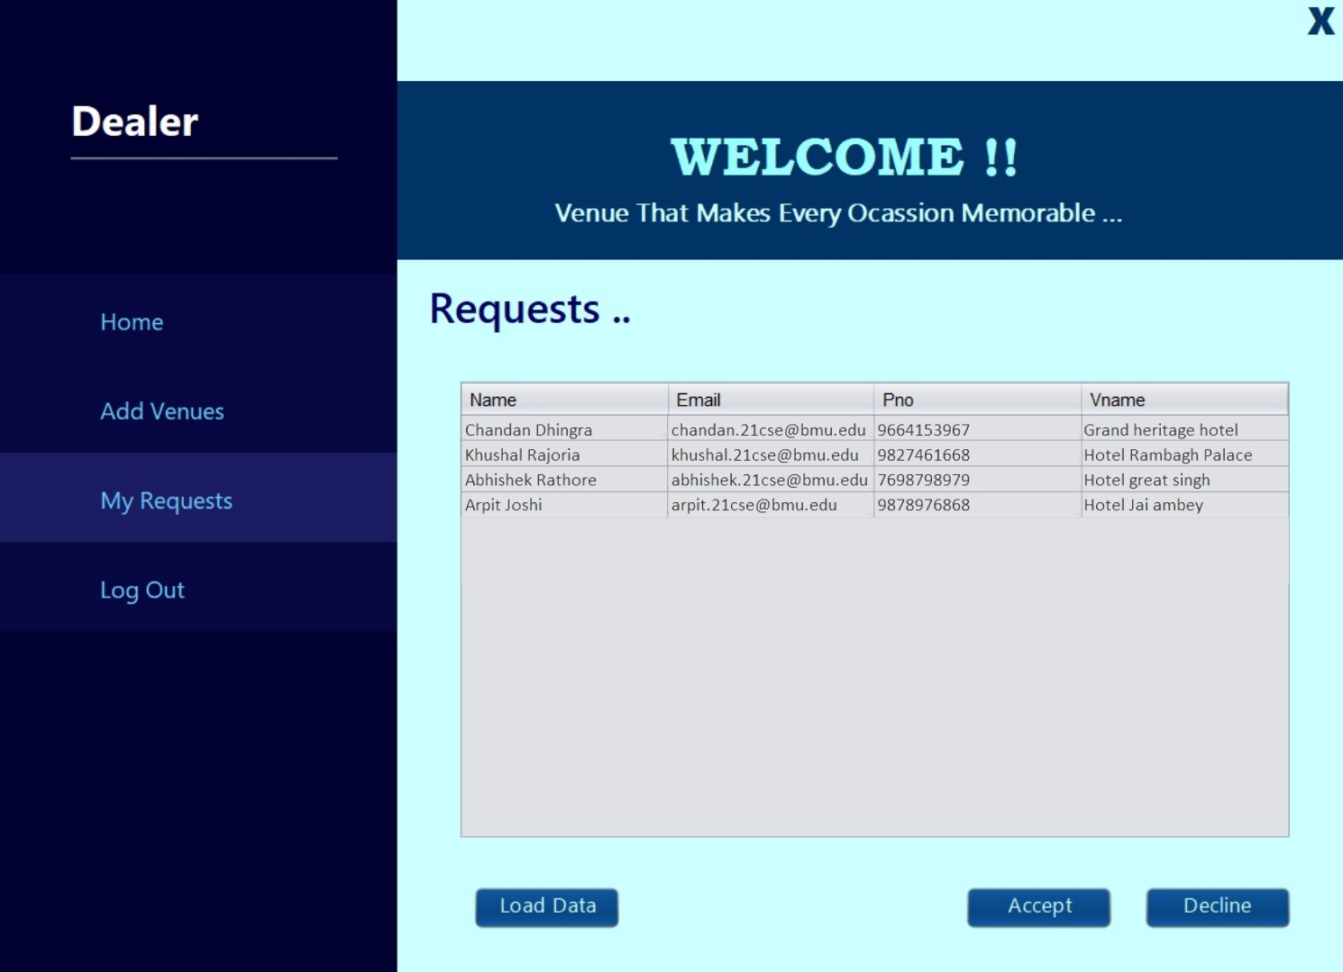
CHECKING REQUESTS
What it’s gonna be like!

Slide 11
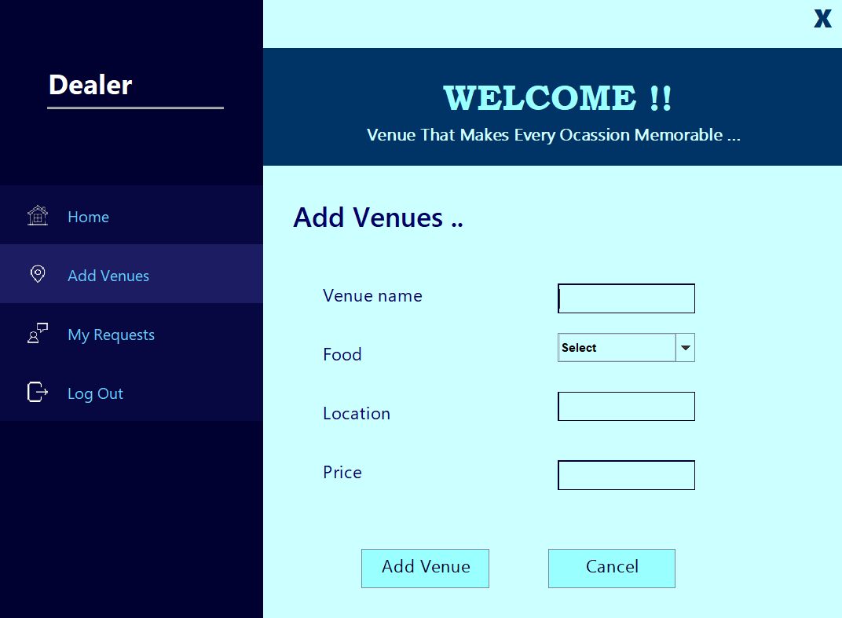
Adding venues
What it’s gonna be like!

Slide 12
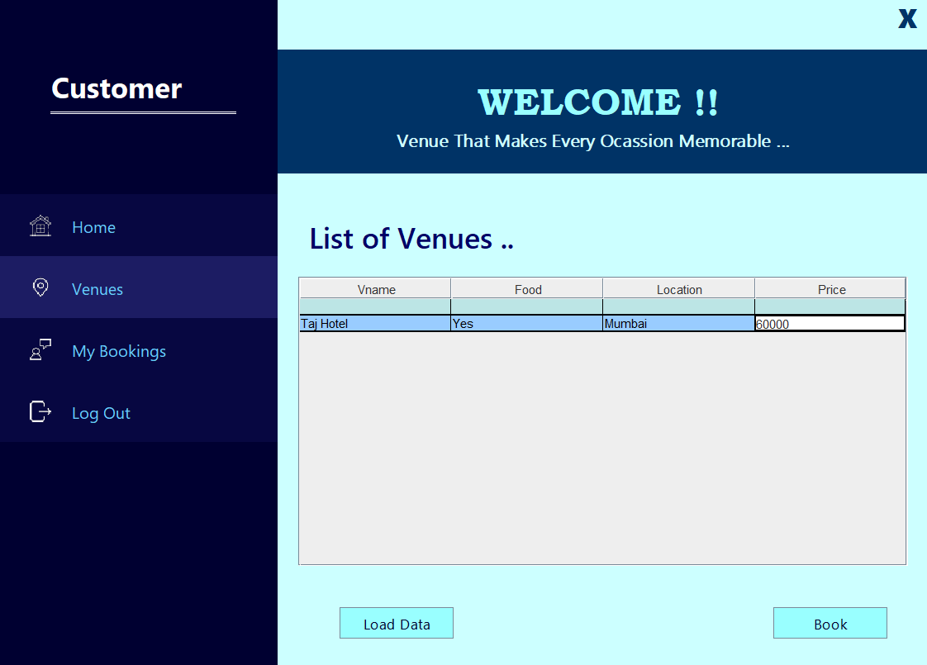
Surfing Venues
What it’s gonna be like!

Slide 13
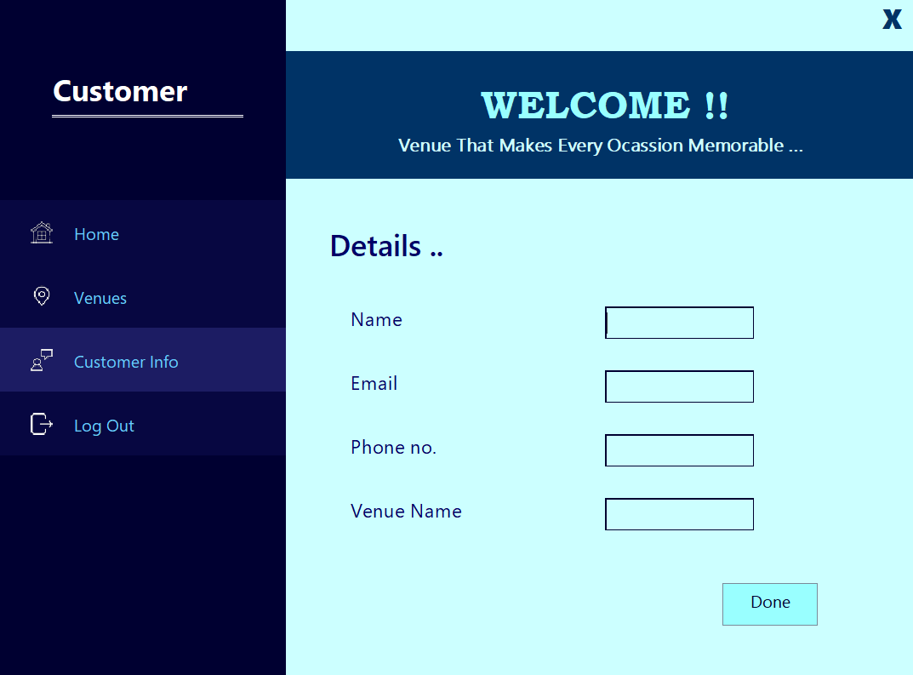
Adding details as customers
What it’s gonna be like!

Slide 14
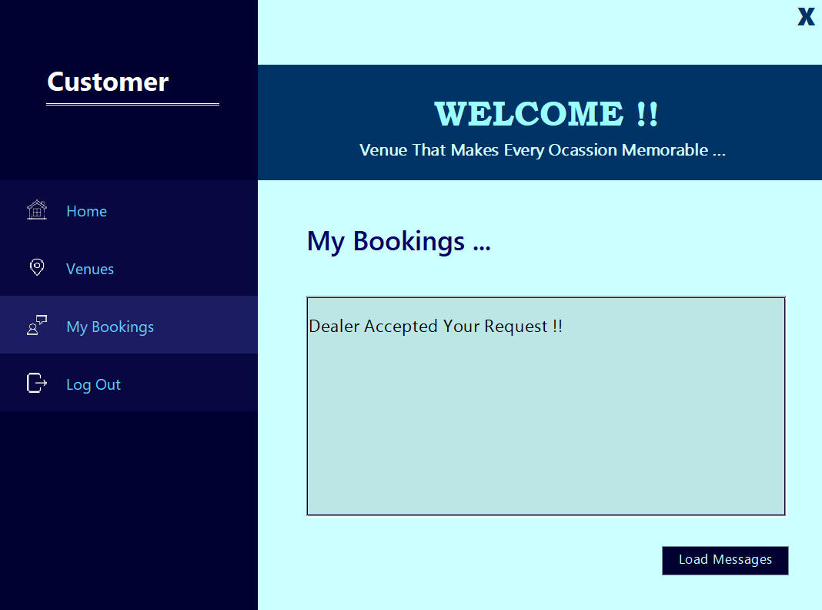
Getting response!
What it’s gonna be like!

Slide 15


Thank you
https://github.com/RathoreAbhiii/venue-management

Slide 16
THANK YOU
Group Members :
Abhishek Rathore : Backend in Java
Khushal Rajoria : Backend in Java
Chandan Dhingra : Backend In Java using MySQL
Arpit Joshi : Frontend using Java Swing
Prakhar Maheshwari : Backend In Java using MySQL

